Slide 1
A Metric for Short-Term Hand Comfort and Discomfort
Exploring Hand Posture Evaluation
Jonas Mayer
Nicholas Katzakis
HUMAN-COMPUTER
INTERACTION
UNIVERSITY OF HAMBURG

Slide 2
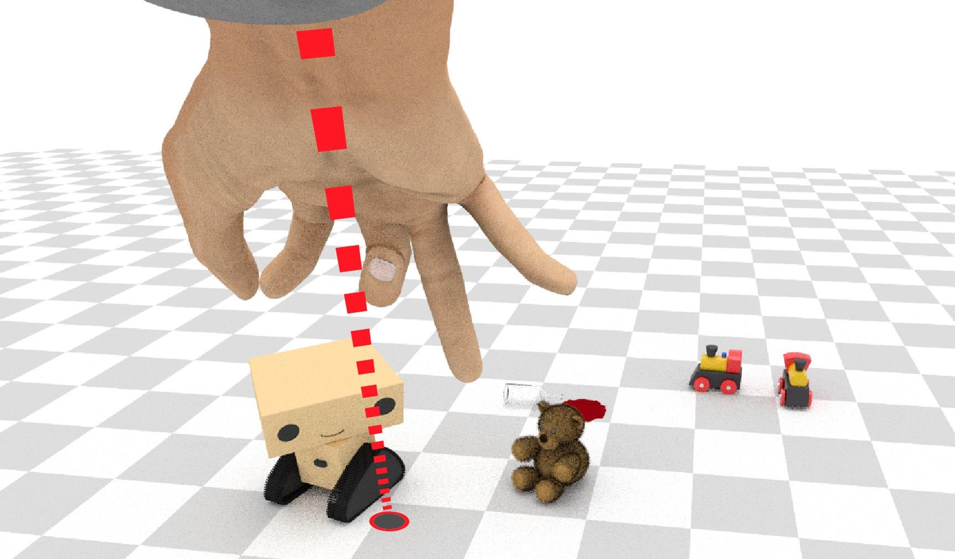
Motivation
Virtual Reality, Human-Robot Interaction: Pointing
Designer challenge: Which hand postures are the best for:
Performance?
User Experience?

Slide 3
Study Goal
Problem: Hand Posture Evaluation Subjective/Work Intensive.
Hypothesis: Hand Posture Comfort/Discomfort Affects Performance - User Experience.
Goals:
Create Metric for Quick/Objective Hand Posture Comfort/Discomfort Evaluation.
Show Effect on Performance in Pointing Task.

Slide 4
Related Work: Comfort and Discomfort (Vink et al.)
Comfort
“Pleasant state or relaxed feeling of a human being”
Influenced by subjective impressions and expectations
Discomfort
“an unpleasant state of the human body”
Caused by physical stress

Slide 5
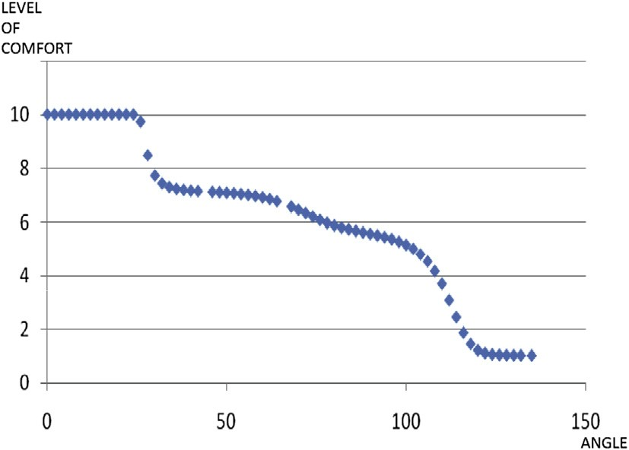
Related Work
Apostolico et al:
Introduced and determined the Range of Rest Posture for human joints (more later)
Naddeo et al:
Propose Quantitative Method for postural comfort evaluation
Comfort based on Distance to Range of Rest Posture
Cons: Complex Computation, Comfort only

Slide 6
Hand Comfort/Discomfort Components
Four components affect hand comfort/discomfort:
Deviation from Range of Rest Posture (RRP)
Inter Finger Angles (IFA)
Finger Hyperextension (HE)
Finger Abduction (FA)

Slide 7
Hand Comfort/Discomfort Components
Deviation from Range of Rest Posture (RRP) (Apostolico et al.)
Every Joint has Rest Posture
When in Rest Posture, Maximum Comfort is Perceived
Deviation from Rest Posture should Decrease Comfort
Due to anatomical differences: look at Range of Rest Posture
In our case: look at the RRPs for all hand joints

Slide 8
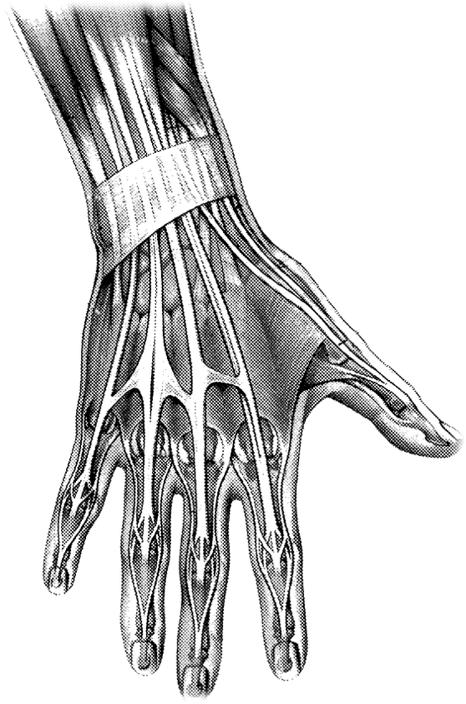
Hand Comfort/Discomfort Components
Inter Finger Angles (IFA)
Complex Hand Anatomy:
Finger extendors and flexors share same muscles
Inter-finger tendons
Individual finger movement limited
High inter finger angle differences create stress on tendons, muscles
Discomfort

Slide 9
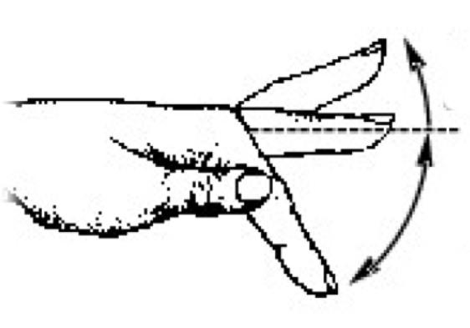
Hand Comfort/Discomfort Components
Finger Hyperextension (HE)
LaViola et al. : “[hyperextension] puts more strain on the [MCP] joints and tendons than the hand is accustomed to”
High stress on joints, tendons, muscles
Discomfort
Hyper-
extension
Extension
Flexion

Slide 10
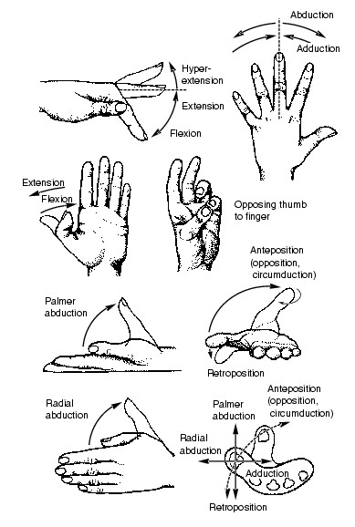
Hand Comfort/Discomfort Components
Finger Abduction (FA)
Analog to hyperextension:
High abduction creates stress on joints, tendons, muscles, soft tissue
Discomfort
Abduction
Adduction

Slide 11
Concrete Implementation: RRP Metric Comp.
Hand Model:
21 DOF Angle Based Hand
Interpret Hand as a vector of length 21
In Theory:
There is a RRP for each DOF
Identify RRP for each DOF
For a particular hand posture, add up the distances to the RPP for each joint
1
1
1
1
1
1
1
1
1
2
2
2
2
1
3

Slide 12
Concrete Implementation: RRP Metric Comp.
For simplicity:
Define RRP for whole hand as a set of 50 relaxed hand postures
Calculate minimum Euclidian distance to RRP set for particular hand
Yields RRP component for whole hand
Metric value 0: maximum comfort
Perceived comfort decreases when metric value increases

Slide 13
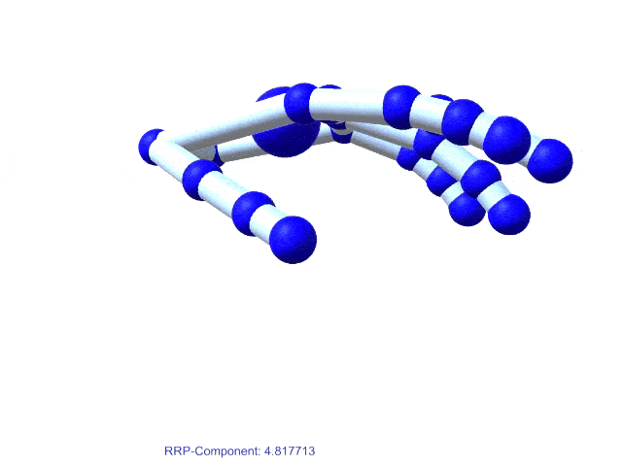
Concrete Implementation: RRP Metric Comp.

Slide 14
Combining the Metric Components
In order to make comparable:
Metric value = 0 → maximum comfort, minimum discomfort
Metric increases → comfort decreases, discomfort increases
Add the component values
Weight with importance coefficients

Slide 15
Combining the Metric Components
Naïve Metric
whole hand component values
importance coefficients empirically estimated
Simple implementation, gives good rough estimate of comfort/discomfort
But: ignores anatomical differences of individual fingers

Slide 16
Combining the Metric Components
Improved Metric
Compute the metric components for each finger, weight finger components individually
Instead of estimating coefficients:
Collect data in user study (with help of naïve metric)
Use machine learning (least squares) to find optimal coefficients

Slide 17
User Study
Objectives for User Study:
Gather data for improving metric
Verify that improved metric reflects perceived user comfort and discomfort
Show that comfort/discomfort affect performance in pointing task

Slide 18
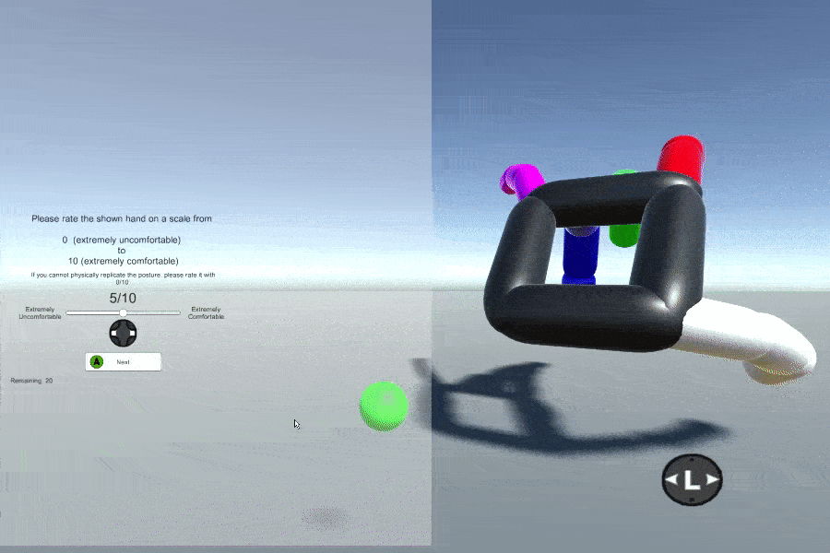
User Study
Task 1: Hand Posture Rating
Generate random hand posture, check with naïve metric and show subject
Subjects Reproduce with Dominant Hand
Rate hand posture on intuitive comfort/discomfort scale from 0 to 10
Beforehand: show relaxed and extremely uncomfortable hand posture for reference

Slide 19
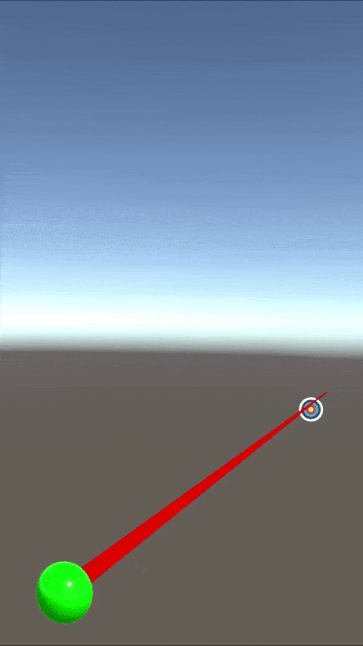
User Study
Task 2: Target Shooting
Again show subject randomly generated hand posture
Again mimic and rate
Perform Target Shooting Task using that Posture
Track Hand w/ Optitrack
Track hand posture with Leap Motion Controller
Measure for performance: total task completion time

Slide 20
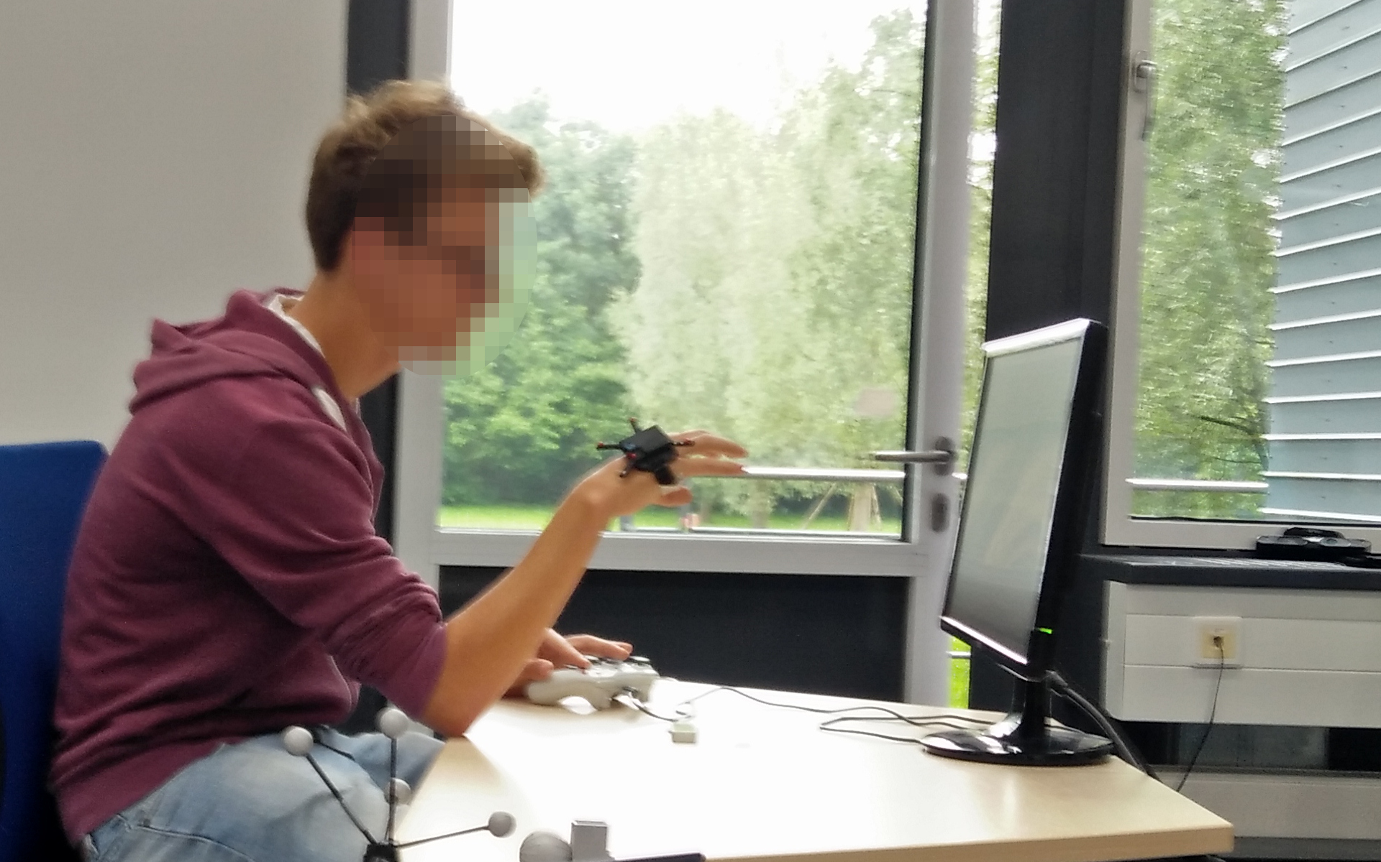
User Study
Main User Study:
Hand Posture Rating, used for improving the metric
Target Shooting, used to investigate impact of comfort/discomfort on performance
Verifying the metric:
Extra round of Hand Posture Rating

Slide 21
Results: Verifying Hand Posture Rating
Pearson Correlation: -0.748993, p-value: 5.89e-12
Improved metric reflects perceived user comfort/discomfort

Slide 22
Results: Target Shooting
Pearson Correlation: -0.6651999, p-value: 6.73e-9
Indicates that comfort/discomfort affect performance

Slide 23
Conclusion
1. Creating a Comfort/Discomfort Metric
Goal: Metric for quick, objective hand posture evaluation
Creation based on
Existing Concepts
Comfort/Discomfort Models
Hand Anatomy and Ergonomics
Tweaked the metric using data from a user study
Verified the metric in a testing user study

Slide 24
Conclusion
2. Showing Importance of Metric
Goal: Show Comfort/Discomfort-Performance Correlation
Tested in Target Shooting Task
Test Results indicate that hand posture comfort/discomfort do affect performance

Slide 25
Future Work
Limitations:
Combined Comfort and Discomfort
Only Short-Term Effects
Develop More Sophisticated Model
Investigate Comfort and Discomfort Seperately
Investigate Short- and long-term effects

Slide 26
Acknowledgements
Nicholas Schneider
Dr. Frieder Pankratz

Slide 27
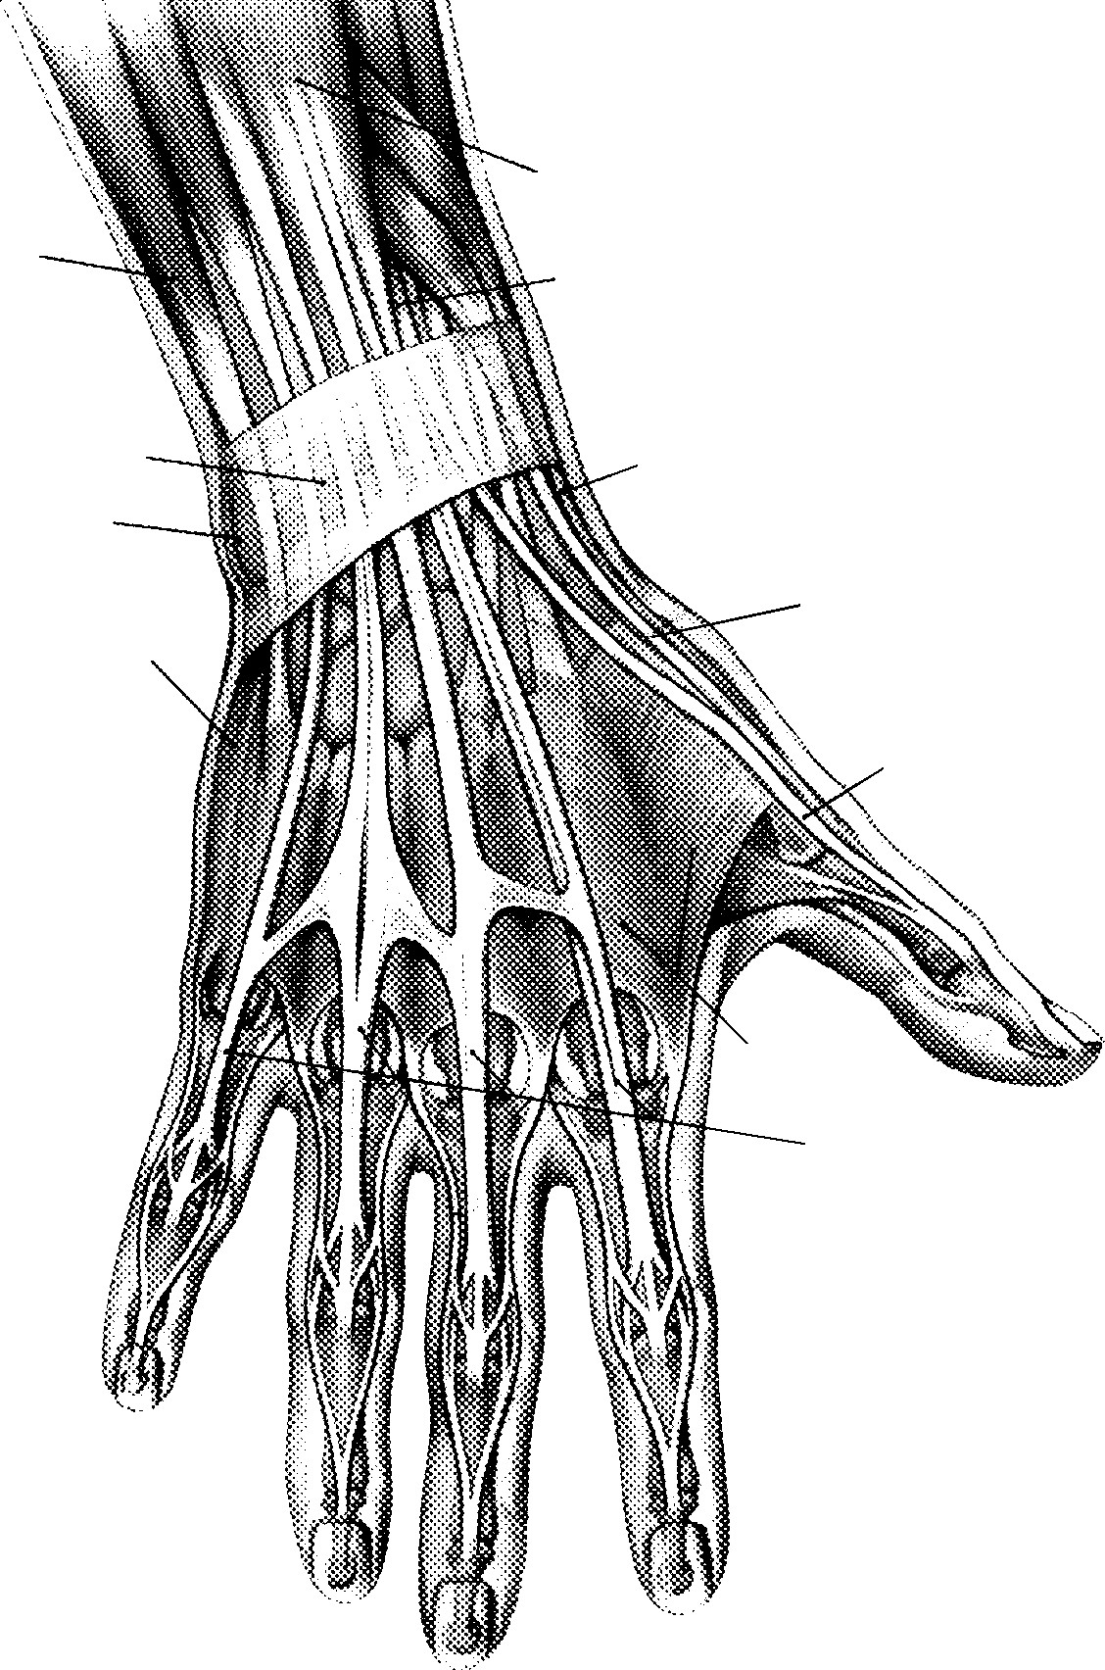
Questions?

Slide 28
Appendix

Slide 29
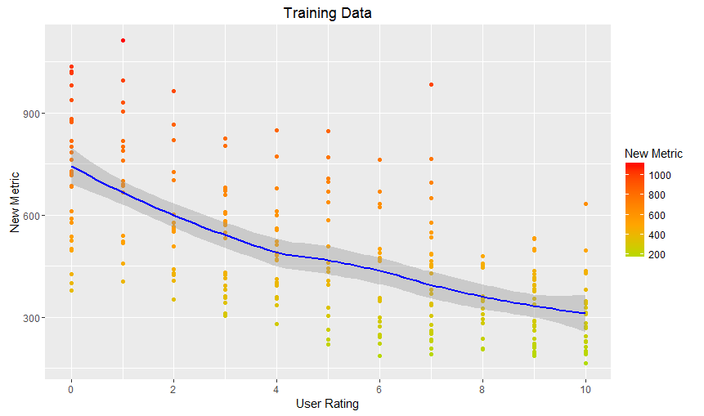
Results
Training Data: Improved Metric and User Rating
Pearson Correlation: -0.6453242
p-value: < 2.2e-16
Not perfect:
Anatomical and psychological differences
Short term effects only
Few discrete steps

Slide 30
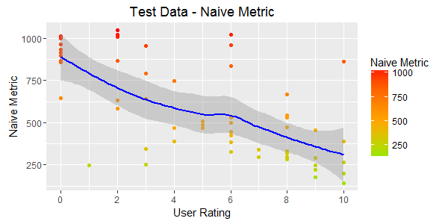
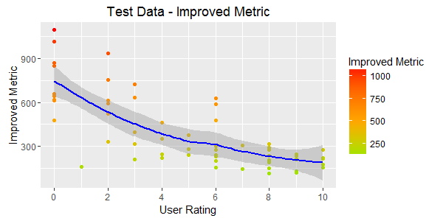
Results
Test Data: Naive Metric and User Rating
Pearson Correlation: -0.6651999
p-value: 6.73e-9
No big difference on first sight
However, standard error is smaller, better correlation

